Slide 1
Embedded Database Benchmark
Team CodeBlooded

Slide 2
Internet of Things
“As the number of interconnected platforms continues to multiply, vendors and customers increasingly require an impartial means of comparing performance, cost-of-ownership and energy consumption across a widening array of hardware and software systems.”
TPC-IoT recently formed (Aug 2015)
Benchmarking already being done on the analytics side - IotaBench
Embedded databases will play a crucial role in the IoT. Benchmarking them w.r.t. IoT will be an important factor in this.
In IoT itself, different workloads possible

Slide 3
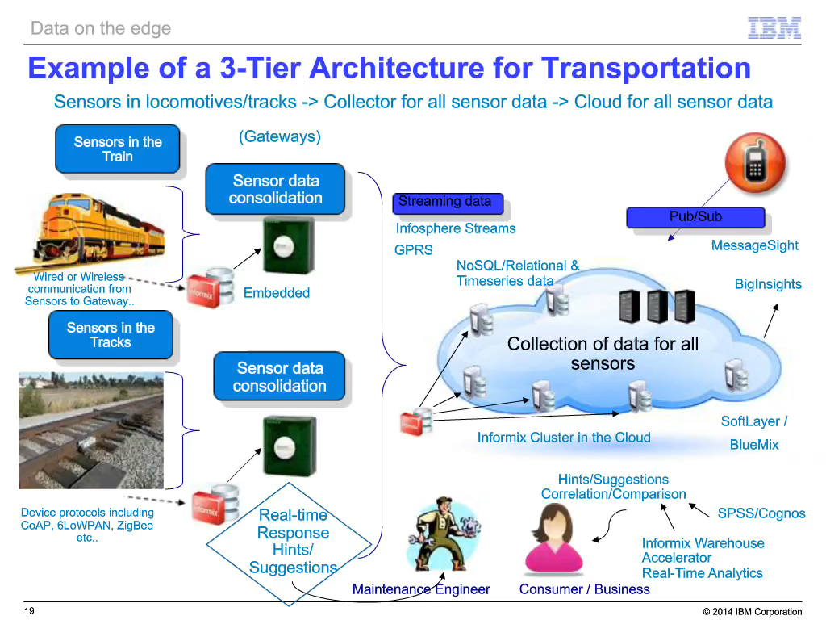
Example

Slide 4
Embedded Databases in IoT
Not overloading backend
  Intermediate filtering, summarize data
No continuous connection required to the backend database
Low latency
  Triggering actions in case of abnormal readings immediately.
Light-weight analytics

Slide 5
Workloads Under Investigation
RFID middleware
  Read only queries for cache.
  Redundancy elimination and data quality.
  Min-max queries and aggregate queries.
  HOPE 2008 data set.
Sensors and Accelerometer
  Write dominant queries.
    Air pollution sensor data set.
Smart Thermostats
  Write and update queries.
    Spark Thermostat – open source.
Notes:
2nd point ->We assumed that they would have aggregate queries but they are more like running averages. Spark thermostat is open source API.

Slide 6
Future Workloads To Research
Set-top boxes
Wearable technologies
Smart Devices

Slide 7
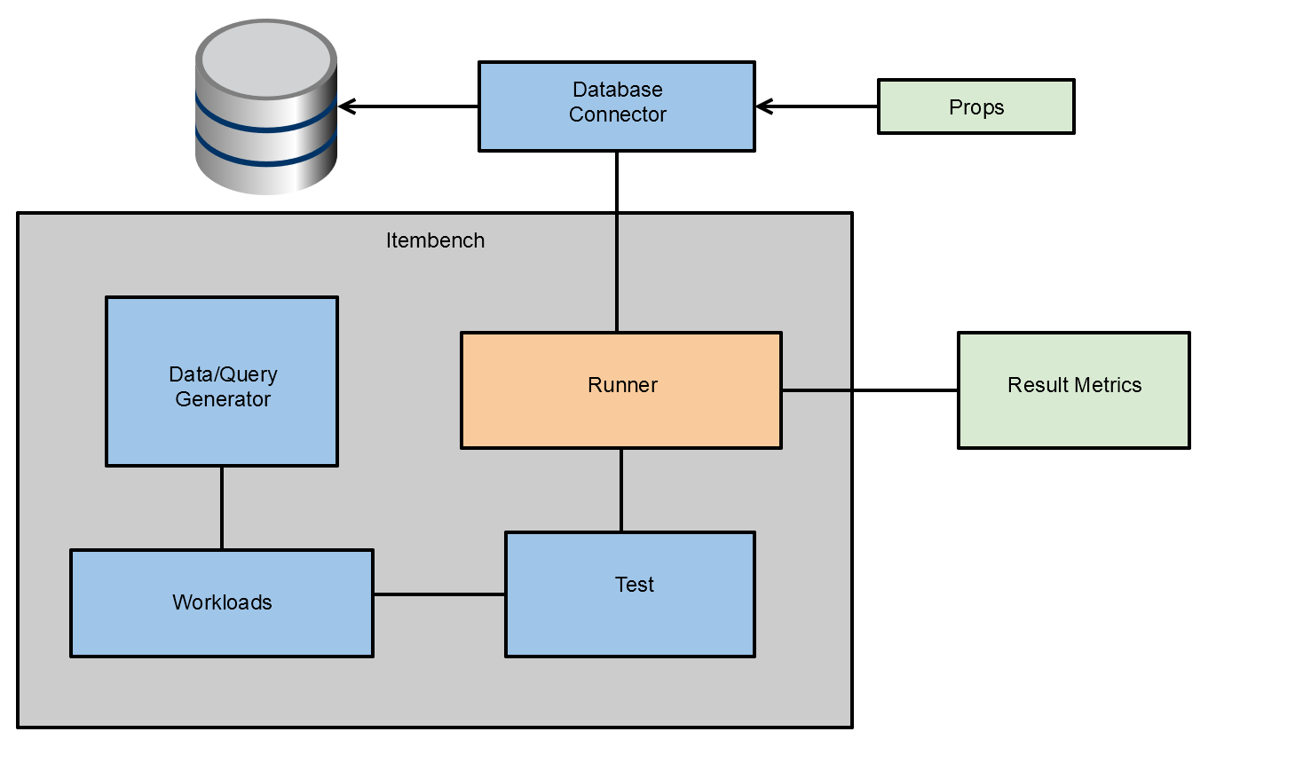
Benchmark Architecture

Slide 8
Metrics
Runtime
Latency
Throughput
CPU Utilization
Memory Usage
SIGAR API to observer OS level metrics

Slide 9
Challenges and Next Steps
Open data sets are available but actual data logs are needed to determine queries.
Decide number of test runs per workload
Implement time series generator for inserts
Iterative development of tests and workloads.

