Slide 1
PocketData Benchmark
Naveen | Sankar | Saravanan | Sathish

Slide 2
Progress
System Implementation:
Analytics generation was taking 6.5 to 8 hrs before.
Implemented two mode approach.
  -m o ➔ Object generation. Read Log file and serialize Statement. Takes apprx. 8hrs.
  -m d ➔ Data Generation. Read Statement generate analytics. Takes apprx. 1 hr 20 mins (sequential version) 40 - 45 mins (parallel version)
  Implemented JSQLParser to be serializable.
Data Generation:
Identifying the table types.
  How many tables does each app uses? how many content provider tables?
  Getting number of columns of each table using pragmas.
  Getting approximate table size using select statements without where clause.
Query Analysis:
Breakdown of 16 applications by their read % and write %.
Assessment of SELECT Complexity in terms of number of returned rows against the queries shot across top 10 applications.
Assessment of a runtime characteristic of the queries [SELECT, UPDATE, INSERT, DELETE] across 10 applications – 5 from the top end of the spectrum; 5 from the bottom.

Slide 3

Log Files
MODE_OBJECT_GEN
parser
Main
parseLogsAndWriteFile
LogParser
<<External>>
shutDown
beans
LogData
Json-simple.jar
JsqlParser.jar
close
write
commons-lang.jar
entity
service
commons-io.jar
<<Abstract>>
AbstractEntity
App
PersistanceService
PersistenceFileService
UnparsedSQLs
User
PersistLogDataService

Slide 4
LogData Objects
MODE_DATA_GEN
beans
parser
LogData
Reader
AnalyticsGen
<<External>>
Queue
Main
run
generate
Writer
Json-simple.jar
shutDown
JsqlParser.jar
commons-lang.jar
write
service
commons-io.jar
close
entity
PersistanceService
<<Abstract>>
AbstractEntity
PersistenceFileService
Sql_log
Analytics

Slide 5
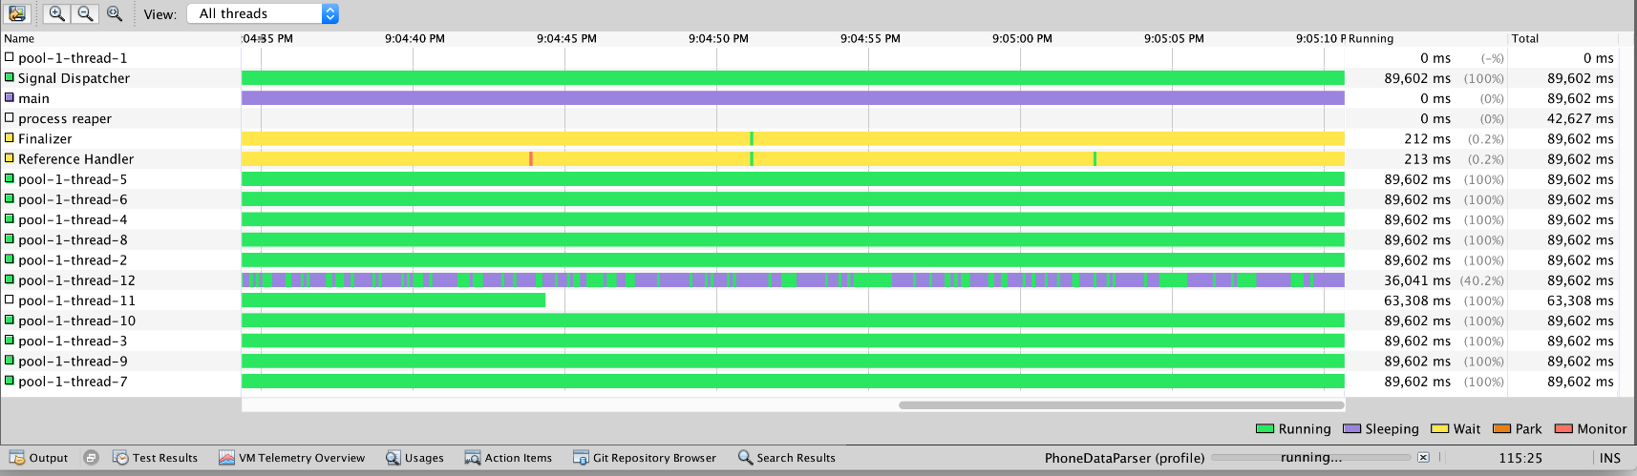
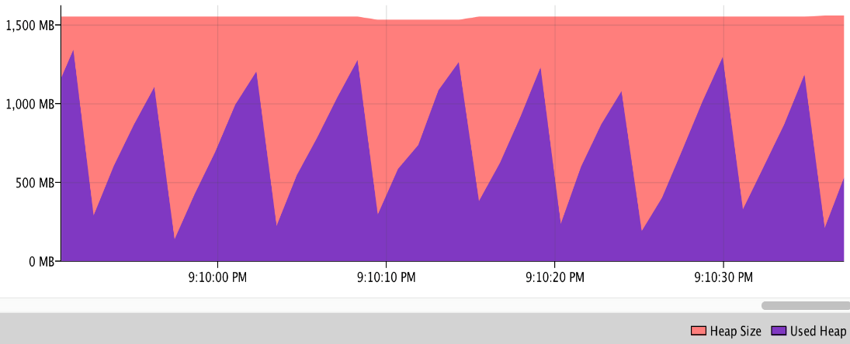
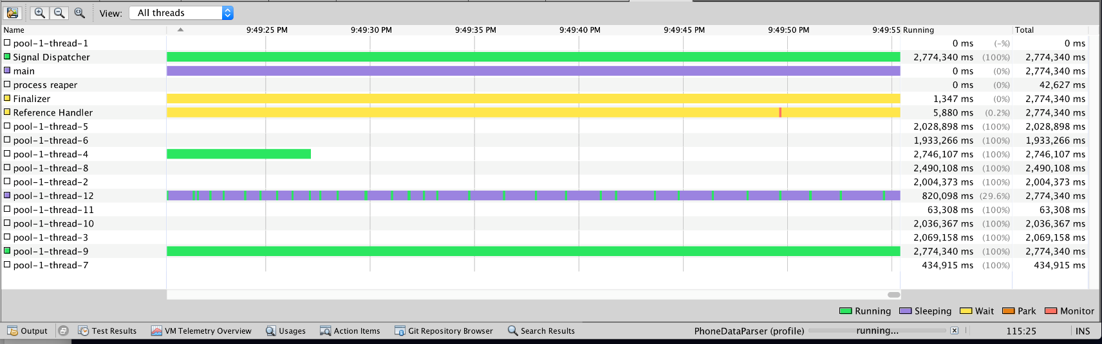
Parser Performance

Slide 6
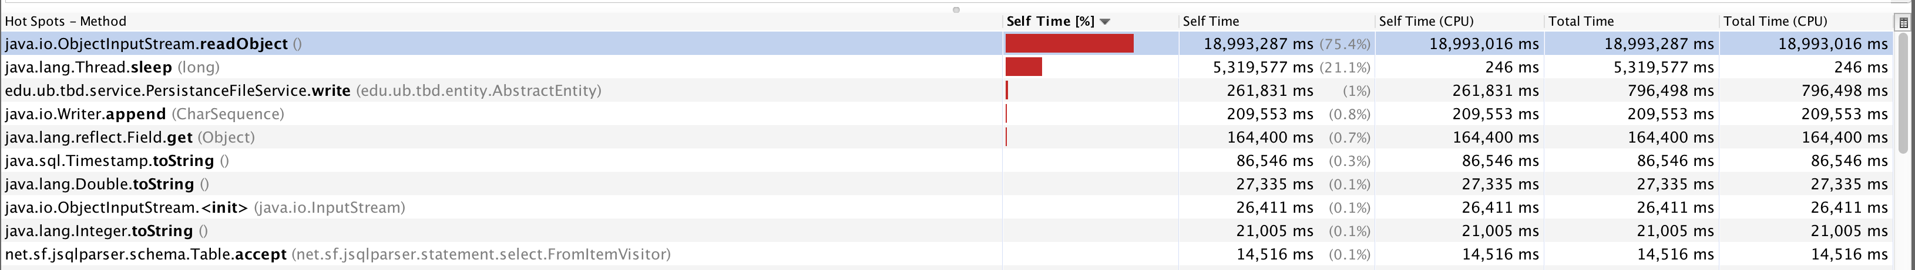
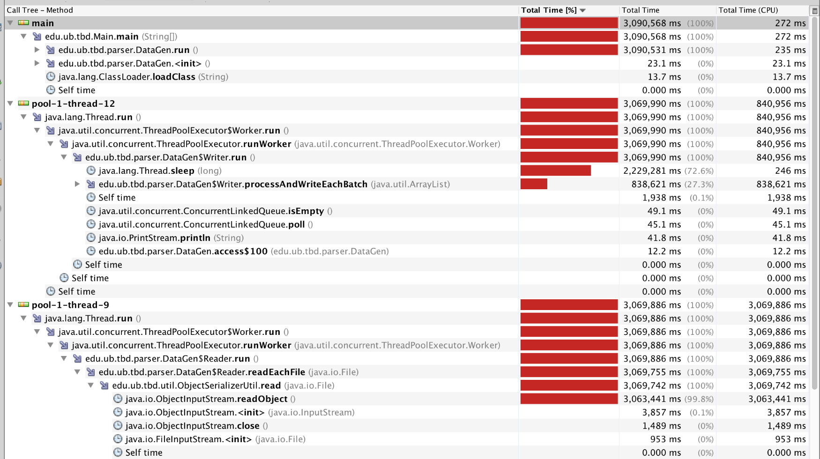
Parser Performance

Slide 7
Data generation
 | Facebook | Whatsapp
PRAGMA types | 136 | 121
PRAGMA types queried more than once | 100 | 48
SELECT query types | 63 | 42
SELECT query with joins | 4 | 2
SELECT (App tables + Content Provider tables) | 53+13 | 10 + 15
UPDATE query types | 14 | 21
UPDATE | 14 | 8
INSERT query types | 23 | 9
INSERT | 23 | 8
DELETE query types | 37 | 6
DELETE | 35 | 6

Slide 8
Read – Write Workloads
Focus: Android System Storage, Cloud Storage, Password Management
Application | Total SQL Queries | SELECT | PRAGMA | INSERT | UPDATE | DELETE
Contacts Storage | 537437 | 268340 | 253913 | 1823 | 3639 | 9722
Calendar Storage | 474202 | 359671 | 103874 | 1471 | 5449 | 3737
Download Manager | 386315 | 383977 | 1668 | 122 | 408 | 140
Facebook | 378161 | 225260 | 53541 | 79409 | 9381 | 10570
Keep | 155714 | 35489 | 96049 | 51 | 13197 | 10928
Google Play Store | 139386 | 50275 | 88420 | 258 | 9 | 424
Drive | 46379 | 29857 | 14262 | 128 | 770 | 1362
Docs | 28217 | 21039 | 4154 | 1120 | 662 | 1242
DropBox | 13582 | 4659 | 4899 | 13 | 2087 | 1924
EventBrite | 6043 | 4486 | 1557 | 0 | 0 | 0
NaverAppStore | 3569 | 631 | 1619 | 4 | 1311 | 4
OneDrive | 2384 | 2297 | 63 | 4 | 12 | 8
KeyChain | 2161 | 890 | 1271 | 0 | 0 | 0
JuiceSSH | 2103 | 670 | 1433 | 0 | 0 | 0
AppStore | 1807 | 535 | 1133 | 4 | 134 | 1
EverNote | 733 | 210 | 422 | 0 | 0 | 101

Slide 9
Read – Write Workloads
Focus: Android System Storage, Cloud Storage, Password Management
Application | Total SQL Queries | SELECT | PRAGMA | INSERT | UPDATE | DELETE
Contacts Storage | 537437 | 268340 | 253913 | 1823 | 3639 | 9722
Calendar Storage | 474202 | 359671 | 103874 | 1471 | 5449 | 3737
Download Manager | 386315 | 383977 | 1668 | 122 | 408 | 140
Facebook | 378161 | 225260 | 53541 | 79409 | 9381 | 10570
Keep | 155714 | 35489 | 96049 | 51 | 13197 | 10928
Google Play Store | 139386 | 50275 | 88420 | 258 | 9 | 424
Drive | 46379 | 29857 | 14262 | 128 | 770 | 1362
Docs | 28217 | 21039 | 4154 | 1120 | 662 | 1242
DropBox | 13582 | 4659 | 4899 | 13 | 2087 | 1924
EventBrite | 6043 | 4486 | 1557 | 0 | 0 | 0
NaverAppStore | 3569 | 631 | 1619 | 4 | 1311 | 4
OneDrive | 2384 | 2297 | 63 | 4 | 12 | 8
KeyChain | 2161 | 890 | 1271 | 0 | 0 | 0
JuiceSSH | 2103 | 670 | 1433 | 0 | 0 | 0
AppStore | 1807 | 535 | 1133 | 4 | 134 | 1
EverNote | 733 | 210 | 422 | 0 | 0 | 101

Slide 10
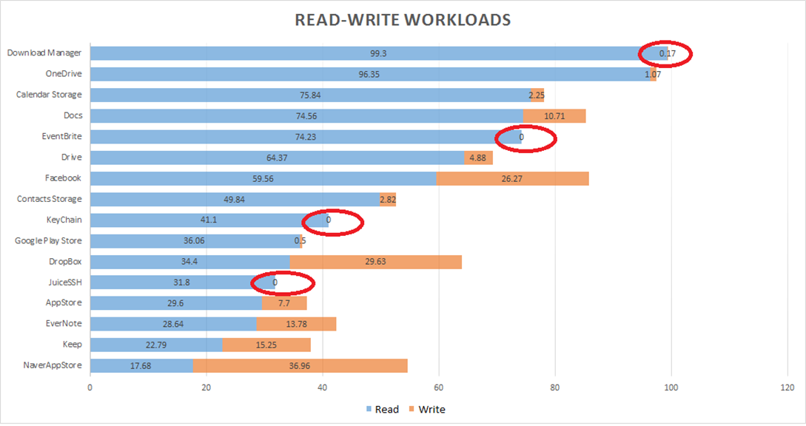
Read – Write Workloads
Focus: Android System Storage, Cloud Storage, Password Management
SQLite – Credential Store

Slide 11
Returned Row Count
Focus: Top 10 Mobile Applications each ranked by the number of queries dealt.
%
Rows Returned

Slide 12
Returned Row Count
Focus: Top 10 Mobile Applications each ranked by the number of queries dealt.
%
Rows Returned

Slide 13
Query Runtime
Focus: 10 Applications, 5 each from the two ends of the spectrum (?)

Slide 14
Query Runtime
Focus: 10 Applications, 5 each from the two ends of the spectrum (?)

Slide 15
Plan Ahead
Analysis on a large scale.
Data Generator.
Checkpoint – 2 Documentation.
Evaluation Strategies.

